Slide 1
Parsing II LL(1) Grammars
Adeesha Wijayasiri

Slide 2
Topics
Define LL(1) Grammar
Examples.
Select sets.
Parse Tables.
“Model” PL grammar:
Not LL(1).
Problems:
Left recursion
Common prefices.
Graph Algorithm for First sets
Graph algorithm for Follow sets
Select sets

Slide 3
LL(1) grammars
Definition:
A CFG G is LL(1)
(Left-to-right, Left-most, 1-symbol lookahead)
iff for all A∊ Φ, and for all A→α, A→β, α ≠ β,
Select (A → α) ∩ Select (A → β) = φ
Select(A → α) = First(α) ∪ Follow(A) if α ⇒* ℇ
First (α) = {t / α =>* tβ, for some β}
Follow (A) = {t / S =>* γAtβ, for some γ, β}

Slide 4
First and follow sets
Definition:
First (A) = {t / A =>* tα, for some α}
Follow (A) = {t / S =>* αAtβ, for some α, β}
Computing First sets:
Build graph (Ф, δ), where (A,B) ∈ δ if
B → γAα, γ =>* ε (First(A) ⊆ First(B))
Attach to each node an empty set of terminals.
Add t to the set for A if A → γtα, γ =>* ε.
Propagate the elements of the sets along the edges of the graph.

Slide 5
First sets
Example: S → ABCD A → CDA C → A
B → BC → a D → AC
→ b →
Nullable = {A, C, D}
{a, b}
S
B
{b}
{a}
A
C
{a}
Black: Steps 2 and 3.
Red: Propagating in step 4
D
{a}

Slide 6
Follow sets
Build graph (Ф, δ), where (A,B) ∈ δ if
A → αBγ, γ =>* ε. Follow(A) ⊆ Follow(B):
any symbol X that follows A, also follows B.
A
X
α
B
γ
ε

Slide 7
Follow sets
Attach to each node an empty set of terminals. Add ⊥ to the set for the start symbol.
Add First(X) to the follow set of A (i.e. Follow(A)) if
B → αAγXβ, γ =>* ε.
Propagate the elements of the sets along the edges of the graph.

Slide 8
Follow sets
Example: S → ABCD A → CDA C → A
B → BC → a D → AC
→ b →
Nullable = {A, C, D} First(S) = {a, b}
First(C) = {a}
First(A) = {a}
First(D) = {a}
First(B) = {b}
So,
Follow(S)={⊥ }
Follow(A)={a,b, ⊥}
Follow(C)={a,b, ⊥}
Follow(D)={a,b, ⊥}
Follow(B)={a, ⊥}
S
B
a
⊥
⊥
a
b
⊥
A
C
a
b
⊥
Now, propagate b.
D
a
b
⊥
And, propagate ⊥.

Slide 9
LL(1) grammars
Example:
S → A {b,⊥}
A → bAd {b}
→ { d,⊥}
Disjoint !
Grammar is LL(1)
OPF | d | b | ⊥
S |  | S → A | S → A
A | A → | A → bAd | A →
PT (not OPF): At most ONE
entry in each table slot.

Slide 10
LL(1) grammars
Example: { b^{n+1}d^{n} / n ≥ 0 }
S → A {b}
A → bAd {b}
→ b {b}
Not Disjoint !
Grammar is not LL(1)
OPF | d | b | ⊥
S |  | S → A
A |  | A →bAd A →b
PT: More than one entry in at least one table slot.

Slide 11
LL(1) grammars
S → begin SL end T → P*T
→ id := E; → P
SL → SL S P → (E)
→ S → id
E → E+T
→ T
Find First sets, Follow sets and Select sets.

Slide 12
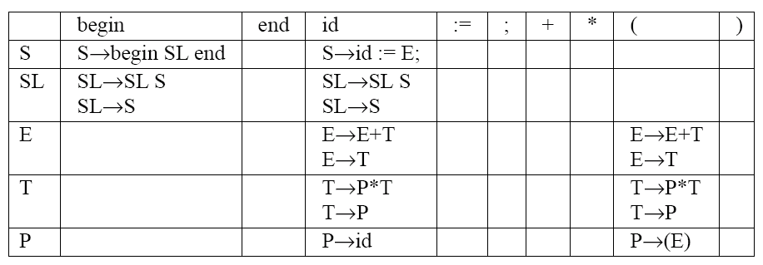
LL(1) grammars
S → begin SL end {begin} T → P*T {(, id}
→ id := E; {id} → P {(, id}
SL → SL S {begin,id} P → (E) {(}
→ S {begin,id} → id {id}
E → E+T {(, id}
→ T {(, id} Select sets not disjoint
Not LL(1)

Slide 13
Non-LL(1) grammars
Left recursion always produces a non-LL(1) grammar, e.g.
SL → SL S
→ S
Common prefices always produce a non-LL(1) grammar, e.g
T → P*T
→ P

Slide 14
Model grammar
S → begin SL end {begin}
→ id := E; {id}
SL → SL S {begin,id}
→ S {begin,id}
E → E+T {(, id}
→ T {(, id}
T → P*T {(, id}
→ P {(, id}
P → (E) {(}
→ id {id}
Problems:
SL is left recursive.
E is left recursive.
T → P * T have common
→ P prefices.
Showing a grammar is not LL(1): easy.
PL grammars:
“mostly” LL(1).
This is our “model” PL sample grammar. We’ll use it throughout.

Slide 15
Top-Down Parsing
Most parsing methods impose bounds on the amount of stack lookback and input lookahead. For programming languages, a common choice is (1,1).
We must define OPF (A,t), where A is the top element of the stack, and t is the first symbol on the input.
Storage requirements: O(n²), where n is the size of the grammar vocabulary (a few hundred).

Slide 16
Ominiscient parsing function
A …
ω
t …
OPF (A, t) = A → ω if
ω =>* tα, for some α.
ω =>* ε, and S =>* αAγtβ,
for some α, β, where γ =>* ε.
or

Slide 17
OPF
Example S → A A → BAd B → b
(Illustrating case 1): → C C →c
OPF b c d
B B → b
C C → c
S S → A S → A
A A → BAd A → C
OPF (A, b) = A → BAd because BAd =>* bAd
OPF (A, c) = A → C because C =>* c
i.e., B begins with b, and C begins with c.

Slide 18
OPF
Example (illustrating case 2): S → A A → bAd
→
OPF b d ⊥
S S → A S → A
A A → bAd A → A →
OPF (S, b) = S → A
OPF (S, d) = --------
OPF (S, ⊥ ) = S → A
OPF (A, b) = A → bAd
OPF (A, d) = A →
OPF (A, ⊥ ) = A →

Slide 19
OPF and LL(1) parsing
Back to Parsing …
We want OPF(A, t) = A → ω if either
t ∈ First(ω),
i.e. ω =>* tβ
ω =>* ε and t ∈ Follow(A),
i.e. S =>* δ Atβ
A α
ω
t β
A α
ω
ε
t β

Slide 20
LL(1) Parsing
Definition: Select (A→ ω) =
First(ω) U
if ω =>* ε then Follow(A)
else ø
So PT(A, t) = A → ω if t ∈ Select(A → ω)
Time to call it PT (Parse Table) rather than OPF, because it isn’t omniscient.

Slide 21
LL(1) Parsing
First and Follow sets:
First (S) = {a, b} Follow (S) = { ⊥}
First (A) = {a} Follow(A) = {a, b, ⊥}
First (B) = {b} Follow(B) = {a, ⊥}
First (C) = {a} Follow (C) = {a, b, ⊥}
First (D) = {a} Follow(D) = {a, b, ⊥}
Grammar Selects sets
S → ABCD {a, b}
B → BC {b}
→ b {b}
A → CDA {a, b, ⊥}
→ a {a}
→ {a, b, ⊥}
C → A {a, b, ⊥}
D → AC {a, b, ⊥}
not disjoint
not pair-wise disjoint
Grammar is not LL(1)

Slide 22
LL(1) parsing
S → ABCD {a, b}
B → BC {b}
→ b {b}
A → CDA {a, b, ⊥}
→ a {a}
→ {a, b, ⊥}
C → A {a, b, ⊥}
D → AC {a, b, ⊥}
Non LL(1) grammar:
multiple entries in PT.
PT a b ┴
S S → ABCD S → ABCD
A A → CDA, A→ a, A → A → CDA, A → A → CDA,A →
B B → BC, B → b
C C → A C → A → A
D D → AC D → AC D → AC

Slide 23
LL(1) Grammars
Definition: A CFG G is LL(1)
( Left-to-right, Left-most, (1)-symbol lookahead)
iff for all A ∈ Ф, and for all productions
A→α, A →β with α ≠ β,
Select (A → α) ∩ Select (A → β) = φ
Previous example: grammar is not LL(1).

Slide 24
Fixing non-LL(1) grammars
Problems with model grammar
Fixing common prefices
Fixing left-recursion
New grammar: LL(1)

Slide 25
Model grammar
S → begin SL end {begin}
→ id := E; {id}
SL → SL S {begin,id}
→ S {begin,id}
E → E+T {(, id}
→ T {(, id}
T → P*T {(, id}
→ P {(, id}
P → (E) {(}
→ id {id}
Problems:
SL is left recursive.
E is left recursive.
T → P * T have common
→ P prefices.
Showing a grammar is not LL(1): easy.
PL grammars:
“mostly” LL(1).

Slide 26
Fixing common prefices
Change: T → P * T { (, id }
→ P { (, id }
to: T → P X { (, id }
X → * T { * }
→ { +, ; , ) }
Follow(X)
⊇ Follow(T) due to T → P X
⊇ Follow(E) due to E → E+T , E → T
= { +, ;, ) } due to E → E+T, S → id := E ;
and P → (E)

Slide 27
Fixing common prefices
In general, change
A → αβ₁
→ αβ₂
. . .
→ αβ_{n}
to A → α X
X → β₁
. . .
→ β_{n}
Hopefully all the β’s begin with different symbols.
If not, repeat !

Slide 28
Fixing left recursion of E
We have (…((( T + T) + T) + T)…)
Instead, we want (T) (+T) (+T) … (+T)
Change: E → E + T { (, id }
→ T { (, id }
To: E → T Y { (, id }
Y → + T Y { + }
→ { ; , ) }
Follow(Y) ⊇ Follow(E)
= { ; , ) }
No longer contains ‘+’:
we eliminated E → E + T

Slide 29
Fixing left recursion
In general,
Change: A → Aβ₁ A → ω ₁
. . . . . .
→ Aβ_{n} → ω _{m}
to: A → ω₁ X X → β₁ X
. . . . . .
→ ω_{m} X → β_{n} X
→
The ω’s don’t begin with A.

Slide 30
Fixing left recursion of SL
We have (…(((S)S)S)…)
Instead, we want (S)(S) …(S)
Change: SL → SL S { begin, id }
→ S { begin, id }
To: SL → S Z { begin, id }
Z → S Z { begin, id }
→ { end }

Slide 31
Modified grammar
S → begin SL end {begin}
→ id := E ; {id}
SL → S Z {begin,id}
Z → S Z {begin,id}
→ {end}
E → T Y {(,id}
Y → + T Y {+}
→ {;,)}
T → P X {(,id}
X → * T {*}
→ {;,+,)}
P → (E) {(}
→ id {id}
Grammar is LL(1) !

Slide 32
Table-driven LL(1) Parsing
Build Parse Table from LL(1) Grammar and Select sets.
Table-driven parsing.
Build Derivation Tree.

Slide 33
Parse table for modified, LL(1) grammar
S → begin SL end {begin} Y → + T Y {+}
→ id := E ; {id} → {;,)}
SL → S Z {begin,id} T → P X {(,id}
Z → S Z {begin,id} X → * T {*}
→ {end} → {;,+,)}
E → T Y (,id} P → (E) {(}
→ id {id}

Slide 35
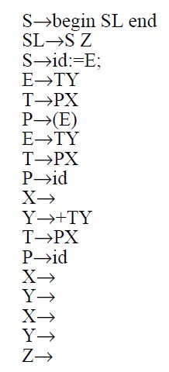
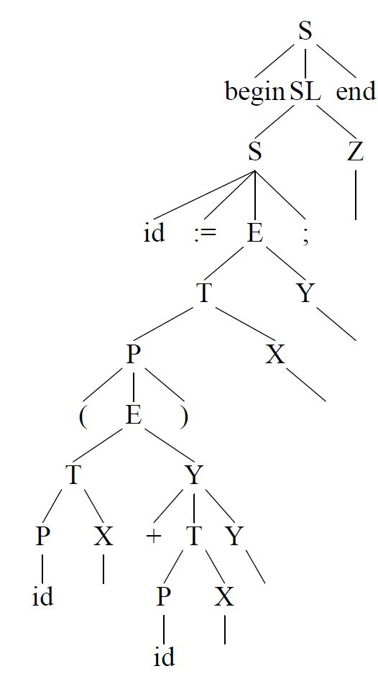
Derivation Tree
Input:
begin
id:=(id+id);
end

Slide 36
Acknowledgements
Programming Language Pragmatics by Michael L. Scott. 3rd edition. Morgan Kaufmann Publishers. (April 2009).
Lecture Slides of Dr.Malaka Walpola and Dr.Bermudez

